Slide 1

Welcome!
Grab a drink, food, and chat with your fellow makers.
Nov 28, 2017

Slide 2

What is Open Hardware?
Open (Source) Hardware, or OSHW, is “hardware whose design is made publicly available so that anyone can study, modify, distribute, make, and sell the design or hardware based on that design.”

Slide 3
Introductions
Name
Day Job / Other Job
Open / Hardware Experience
Tech gift giving or hoping for?

Slide 4
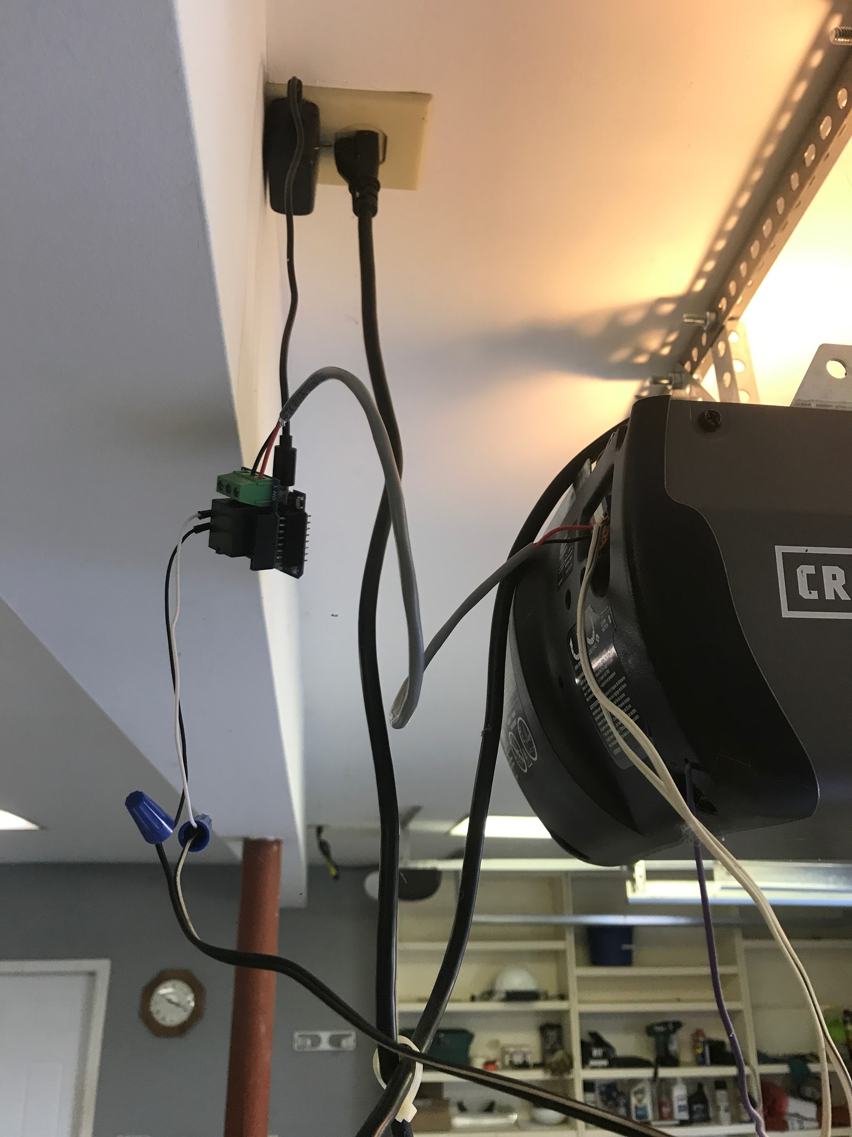
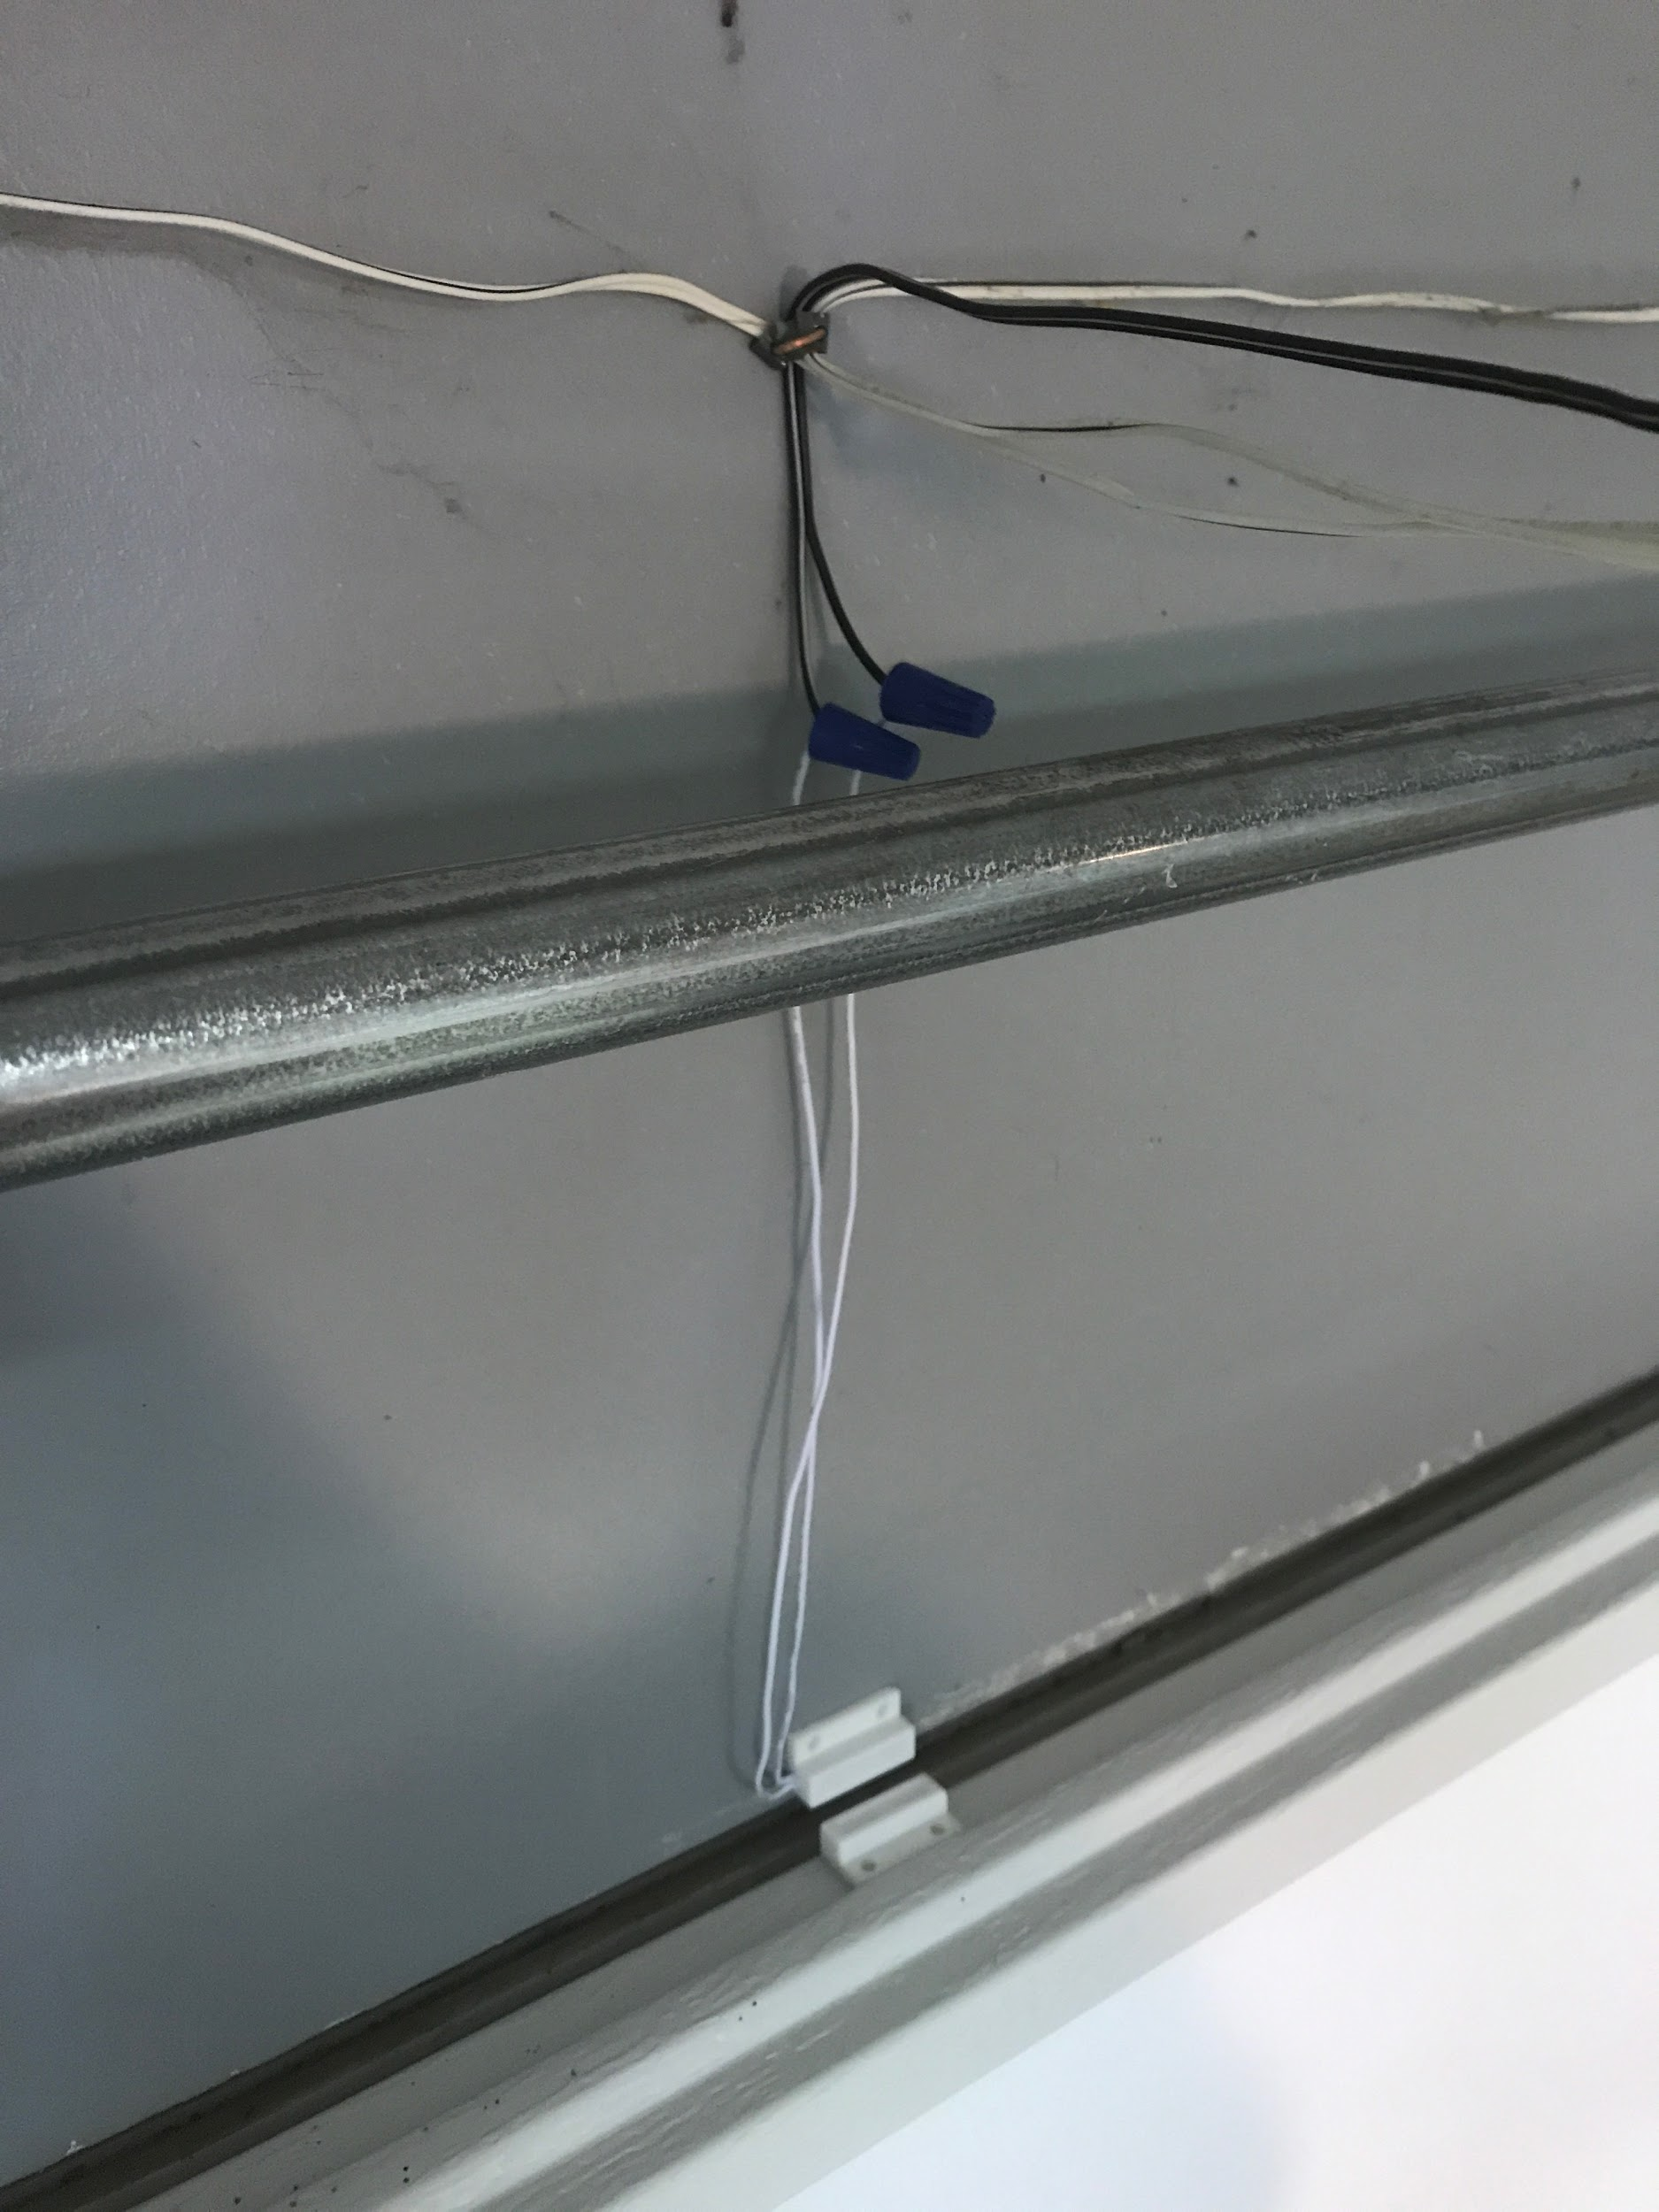
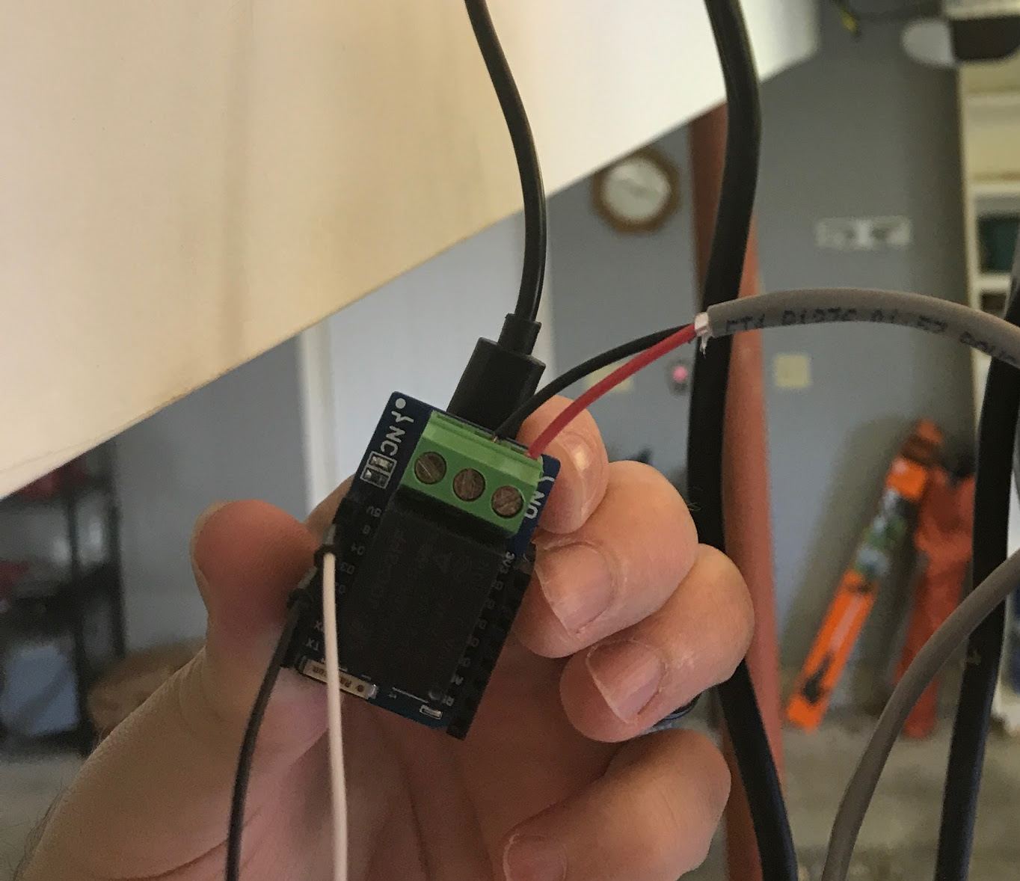
Presentation: Basic Smart Garage Door

Slide 5
Basic Smart Garage Door: Goals
Cheap
Quick
Phone Controlled
Externally accessible
Sharable

Slide 6
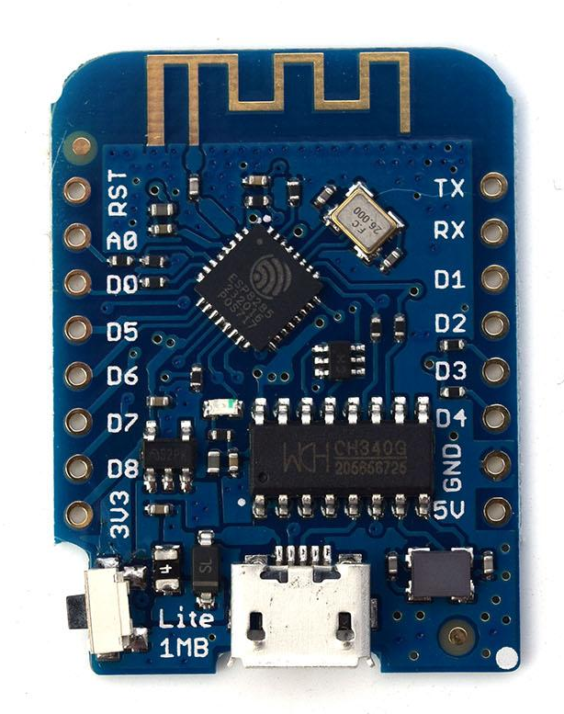
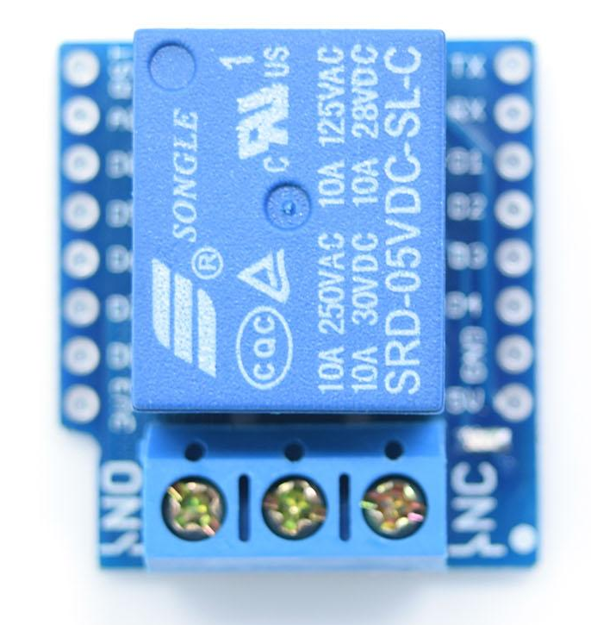
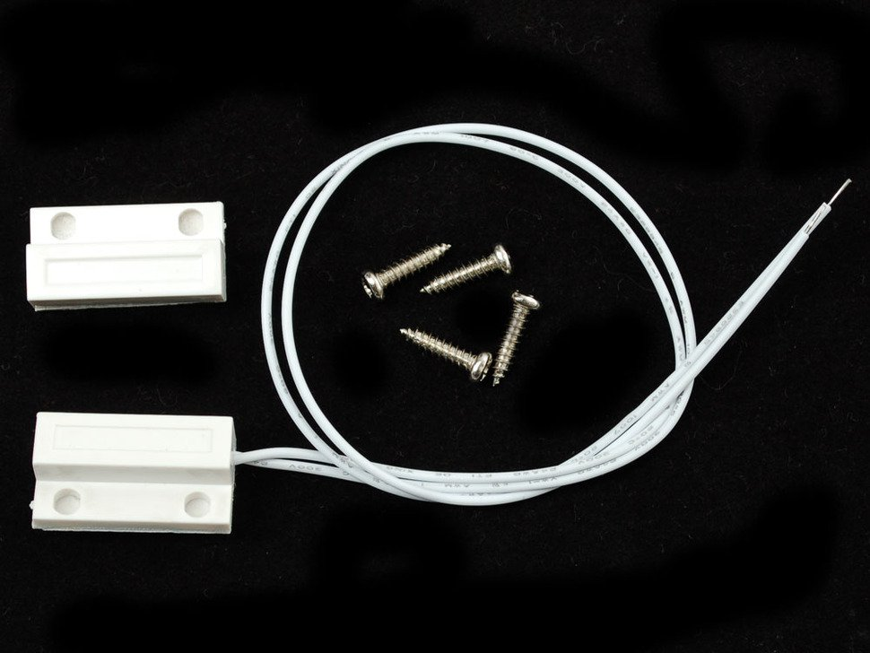
Basic Smart Garage Door: BOM
Description | Part Number | Cost
Wifi Board | D1 mini lite | $3.00
Relay Board | Relay Shield V2 | $1.20
Power Adapter | 501 | $5.95
USB Cable | 592 | $2.95
Contact Switch | 375 | $3.95
Speaker Wire | AH100R | $5.74
Wire Nuts | 30-072P | $7.58
Hookup Wire | 153 | $4.95

Slide 7



Basic Smart Garage Door: Tools
Arduino IDE
Blynk App
Bubble.is

Slide 8
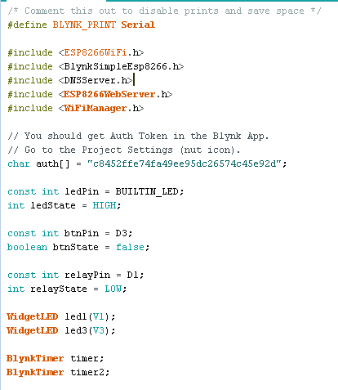
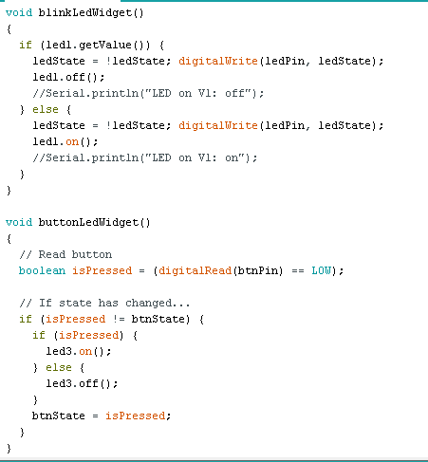
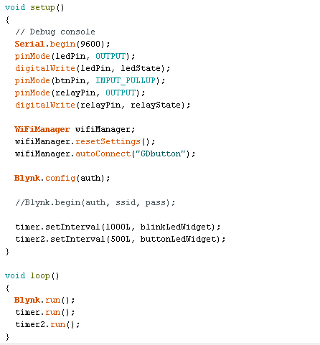
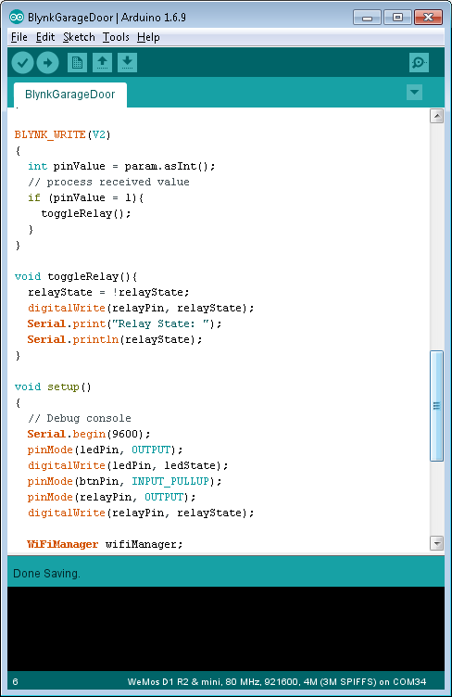
Basic Smart Garage Door: Arduino

Slide 9
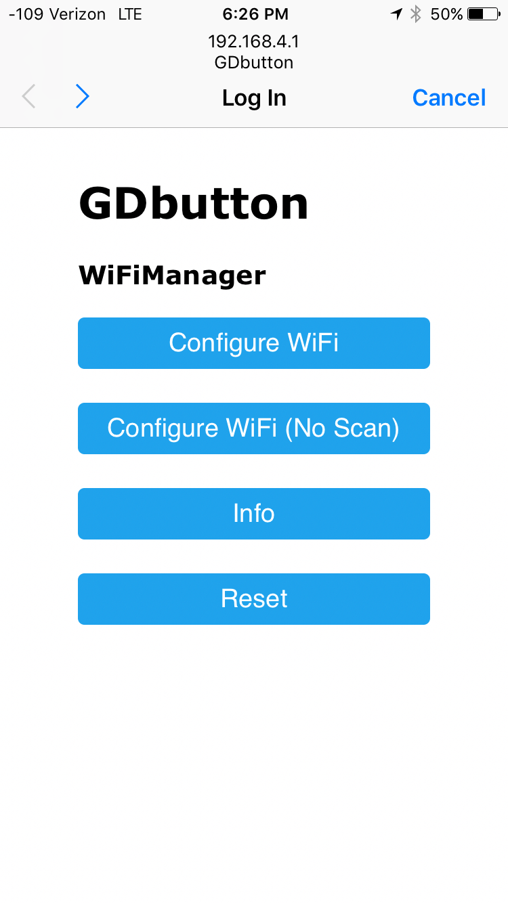
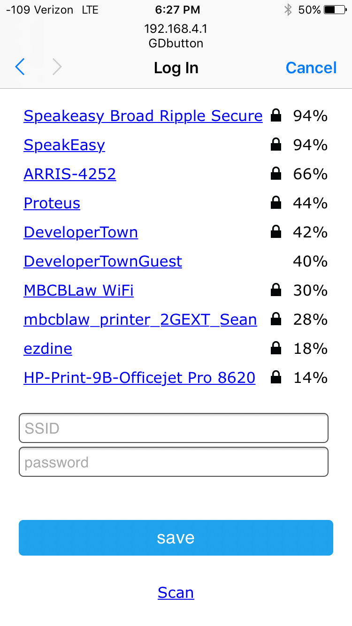
Basic Smart Garage Door: Arduino - WiFiManager

Slide 10
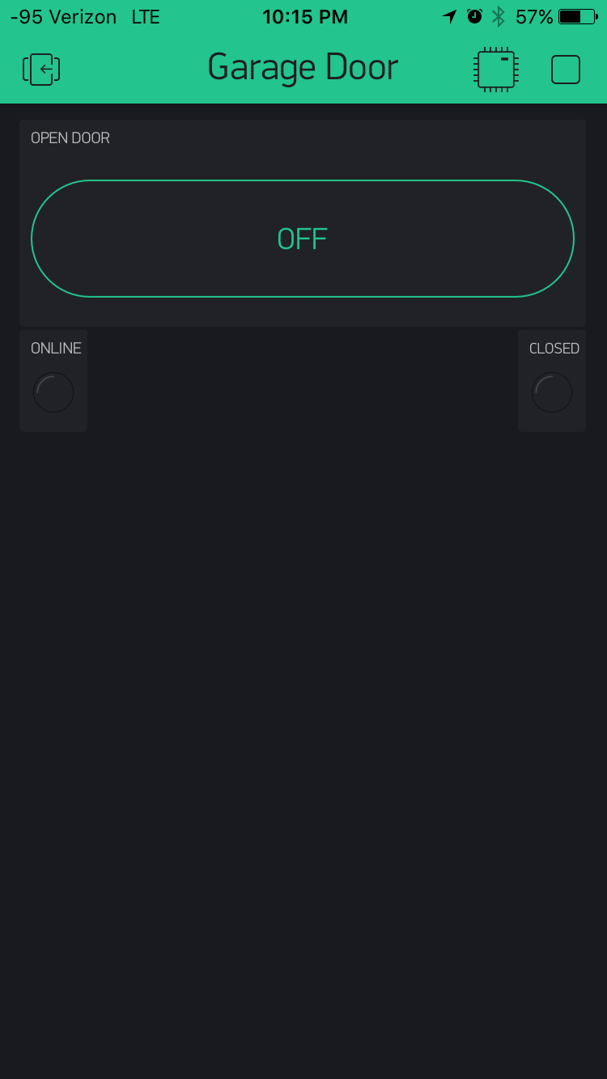
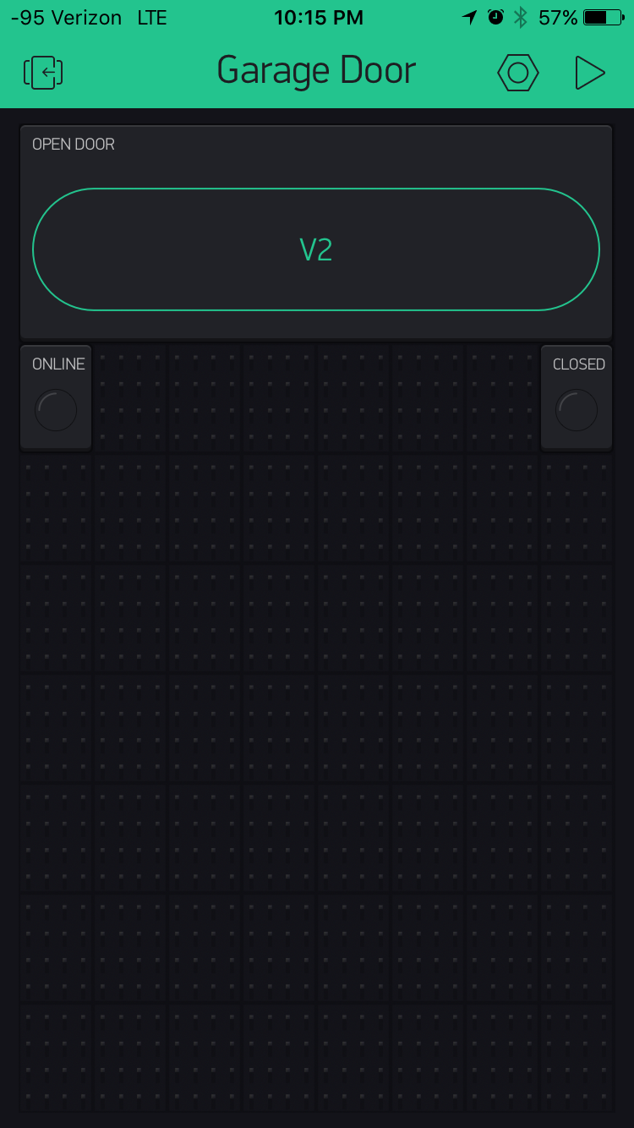
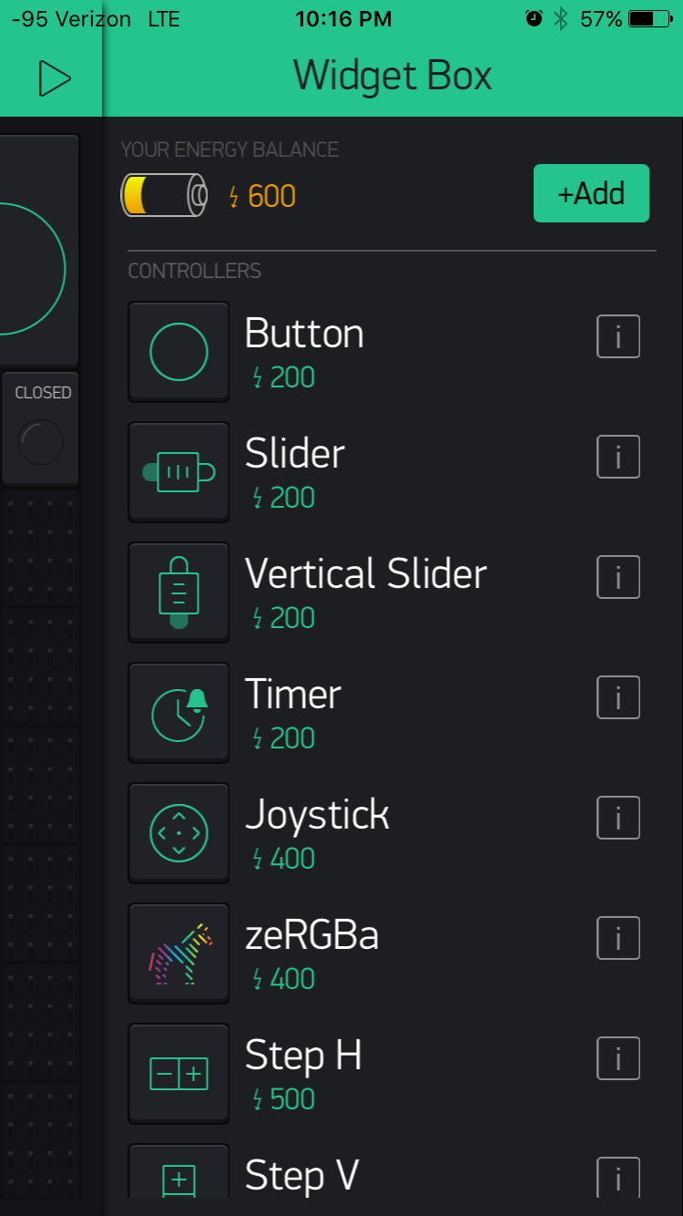
Basic Smart Garage Door: Blynk

Slide 11
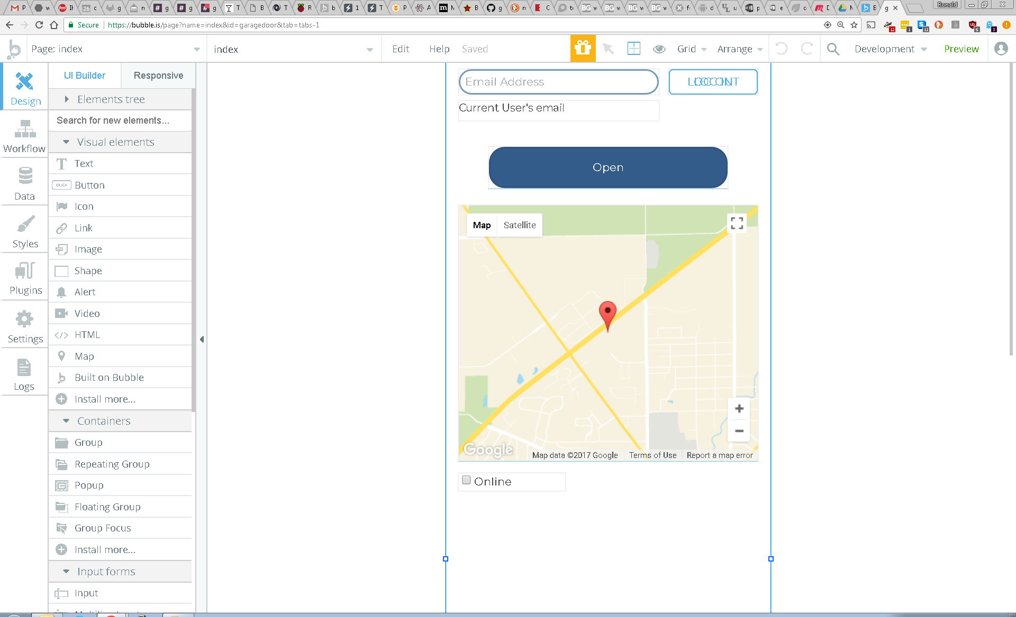
Basic Smart Garage Door: Bubble.is

Slide 12
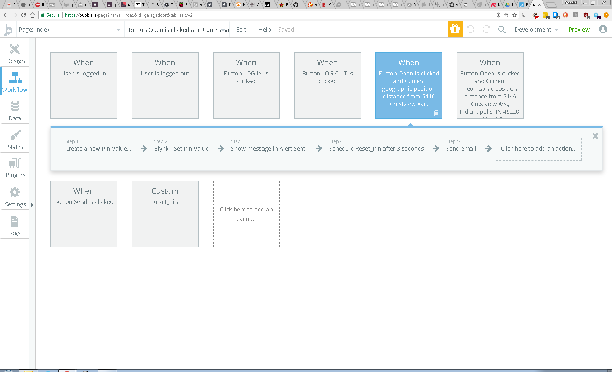
Basic Smart Garage Door: Bubble.is

Slide 13
Basic Smart Garage Door: Questions

Slide 14

indyopenhardware@gmail.com
@INOpenHardware
meetup.com/Indy-Open-Hardware-Meetup github.com/IndyOpenHardware

